Slide 1

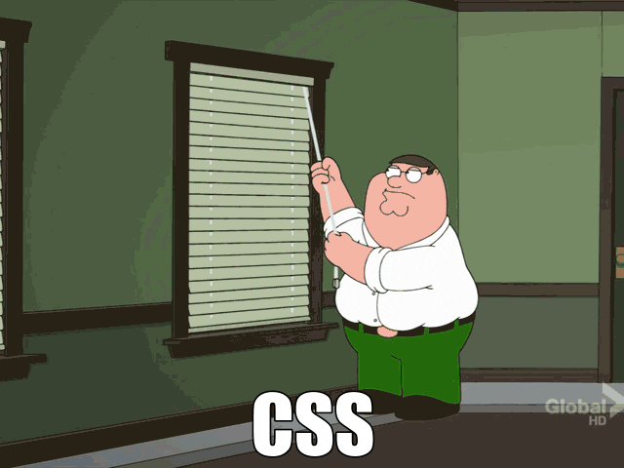


Team 4
MIT Datathon
May 18-19, 2023

Slide 2







Our Amazing Team
Alexa - future astronaut
Heidy - future emergency doctor
Angela - future amazing nurse
Lucas - talented data expert
Dom - best absent doctor
Amelie - always asking questions

Slide 3
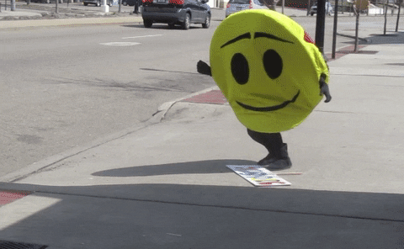
How We Started
We started looking at the data!
What is relevant??? What is important???
Bring in the doctors!
How to communicate across different backgrounds?
We struggled with making a pie graph!
Not knowing everything is ok!
We are all here to learn, not compete!
We spent a lot of time trying to connect to the workshops.
How do we optimize our workflow?
Thank you Judy!

Slide 4
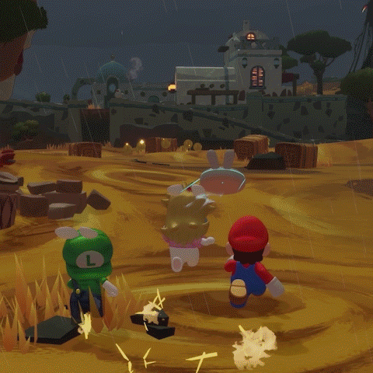

Exploration!

Slide 5
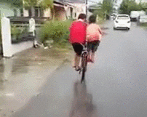
Can We Work More Efficiently?
Data Team
Slowly work through the workshops
Focus on students understanding how the code works
Stop to ask for student’s input
Explore effective techniques for visualization
Learning is better than finishing workshops
Clinical Team
Look at the parameters to raise questions
Answer these questions with some easy coding
Examples :
Does the insurance have an impact on the length of stay in the hospital?
What is the age of each race group going to the ICU?
Is there a correlation between the delay between the SaO2 and SpO2 measurement and the duration of the stay in the ICU?

Slide 6
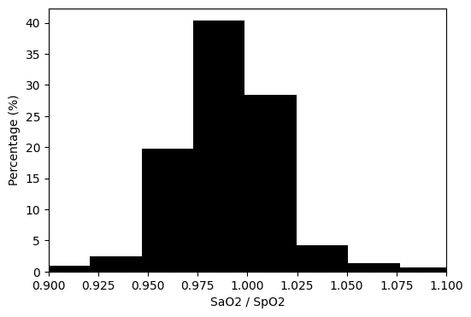
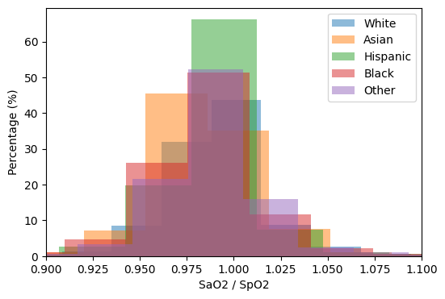
Why is Slowing Down Better?
Insight!! Why?!

Slide 7
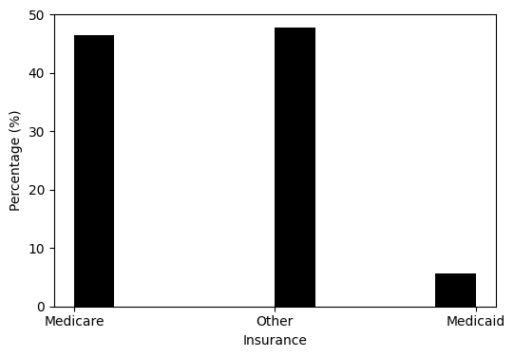
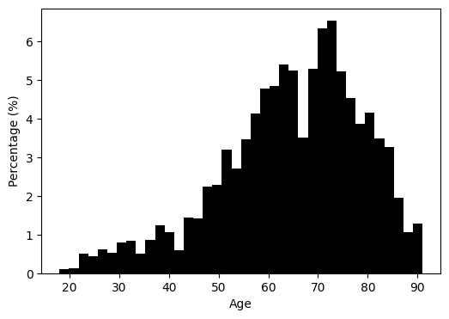
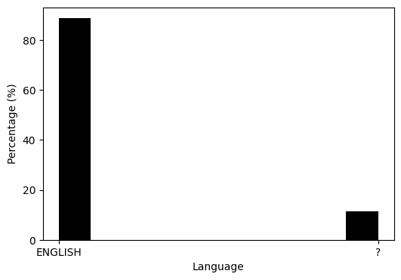
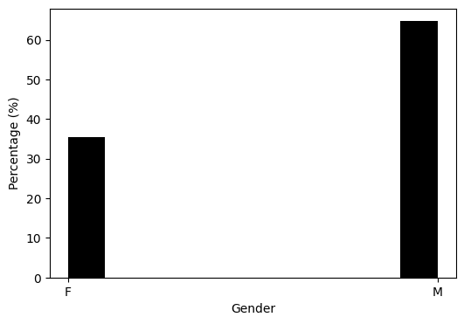
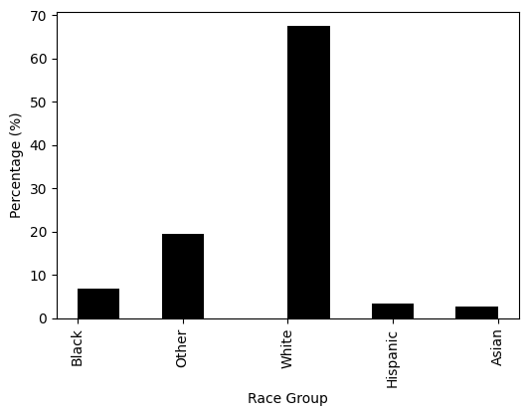
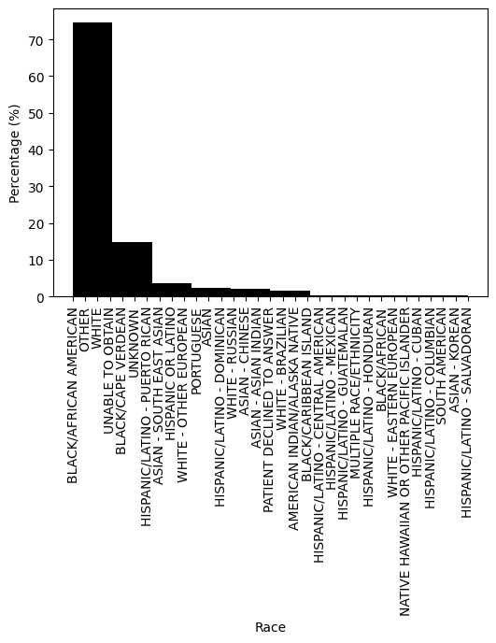
Exploring Data Distributions

Slide 8
That’s Cool But What Does it Mean?

Slide 9

In Simple Terms
We have sampling bias!
50% of insurance is “other”
How do we interpret this?
Age range is wide
Does age affect SpO2? Do we need to bin the ages?
10% don’t speak English
Can they effectively communicate their problems?
Majority white and male
We may run into minority under-representation

Slide 10

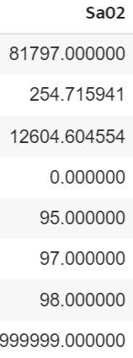

Discussion
Biases are everywhere!
Example of amazon and automated CV screening
Why not draw blood for everyone? Or at least calibrate the pulse oximeter. Like the glucose monitor.
Finishing all of the workshops is not a good idea
We must understand the data the interactions
Data is messy!

Slide 11




Constructive Criticism
Tech issues limited productivity on day one
Have the students set things up online before the datathon
Too much information all at once
Simplify language or provide definitions
Maybe provide a welcome packet w/ notebook to take notes
Positive Feedback
We got to meet new people and collaborate
We got a better understanding of what a data scientist does.
The food was good.
Good team work
The experience was resourceful and we learned the importance of getting thorough data from patients

Slide 12
Exploratory Questions About the Data
Is there a correlation between the delay between the SaO2 and SpO2 measurement and the duration of the stay in the ICU?
=> YES. People that had the longer delay between samples did not stay longer than 40 days. Maybe because they are in better condition
Does this delay differ between Male and Female?
=> NO.
What is the age of each race group going to the ICU?
=> Black and hispanic are close to 59, asian and other are 62 and white is 66. Older people go more often to the ICU because they have more health issue so the average is high.

Slide 13
Exploratory Questions About the Data
Does the insurance have an impact on the length of stay in the hospital?
=> NOT REALLY. On average, people stayed around 22 days. Only 4000 measurements were found about medicaid.
Does the gender have an impact on mean blood pressure?
=> NO. Same distribution was found.

Slide 14
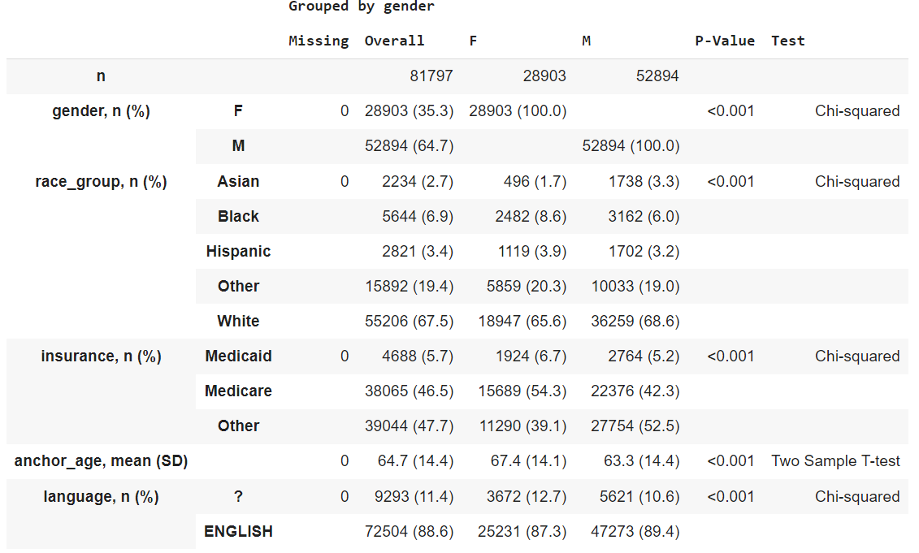
Data Distribution Overview

Slide 15
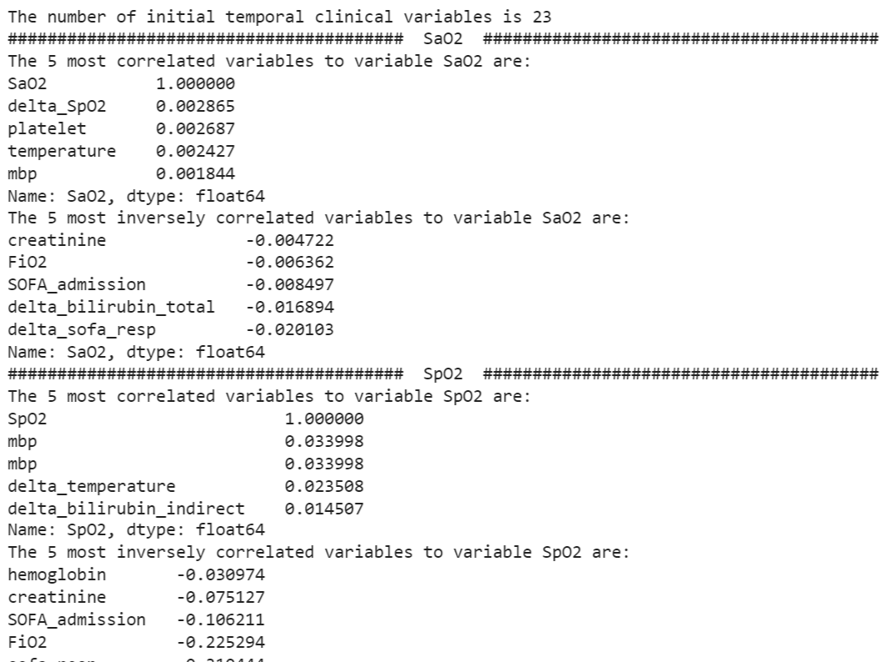
We Could Do This But
….
Boring!

Slide 16
What is Actually Important?

Slide 17
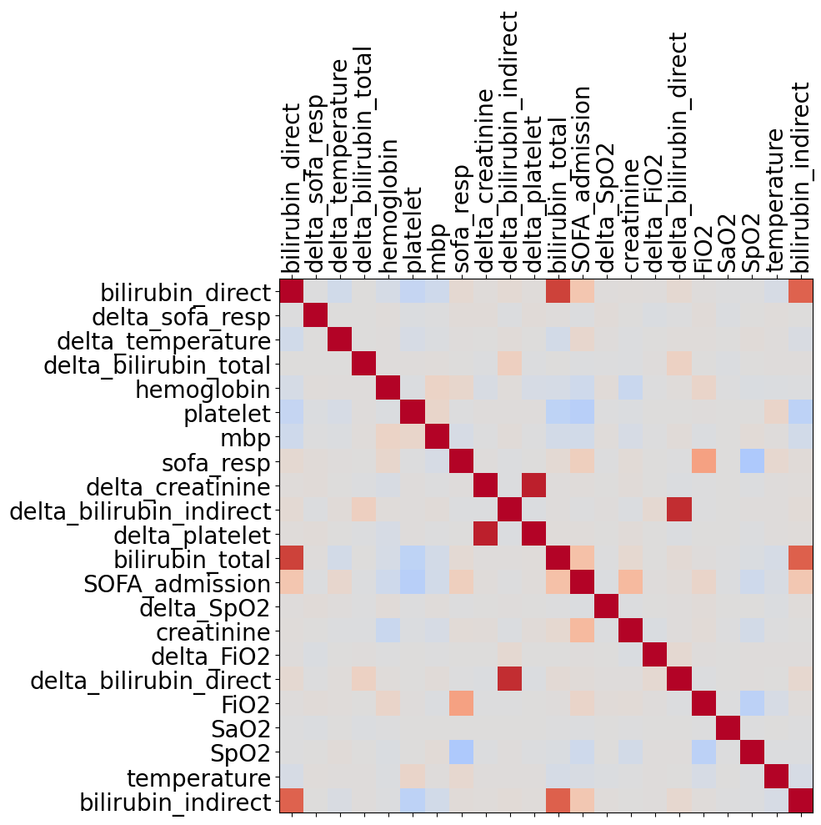
Here We Go!
…
Now
…
Is Every Variable Important?

